Slide 1

Human Face Restoration using GFP-GAN
Team Details
1. A. Gayatri (20EG105602)
2. K. Sathwika (20EG105622)
3. P. Akhil (20EG105704
Project Supervisor
Dr. P. Nagaraj
Assistant professor, CSE
Department of Computer Science and Engineering
1

Slide 2
Introduction
This project uses a Deep learning algorithm called GFPGAN to enhance facial features in videos. It does this by extracting individual frames, applying the algorithm to each frame, and then recombining them into a restored video. This approach ensures that the enhancement is consistent throughout the video. The project also uses MoviePy to integrate the refined frames seamlessly and preserve the original audio track. This combination of techniques makes this project unique and has the potential to be used for film restoration, archival preservation, and other applications.
Department of Computer Science and Engineering
2

Slide 3
Problem Statement
The existing video restoration techniques are remarkable in addressing challenges such as noise reduction and upscaling, significantly enhancing overall video quality. However, a limitation can be noted as these methods often fall short in preserving and enhancing crucial facial details, resulting in a final output that appears blurry and unnatural. This drawback motivates a need for a targeted solution focused specifically on facial feature enhancement within videos.
Disadvantages:
Blurred facial features
Unnatural smoothing
Temporal inconsistencies
Department of Computer Science and Engineering
4

Slide 4

Problem Illustration
Standard face restore methods often over-smooth faces, leading to unrealistic, plastic-like appearances.
Department of Computer Science and Engineering
4

Slide 5
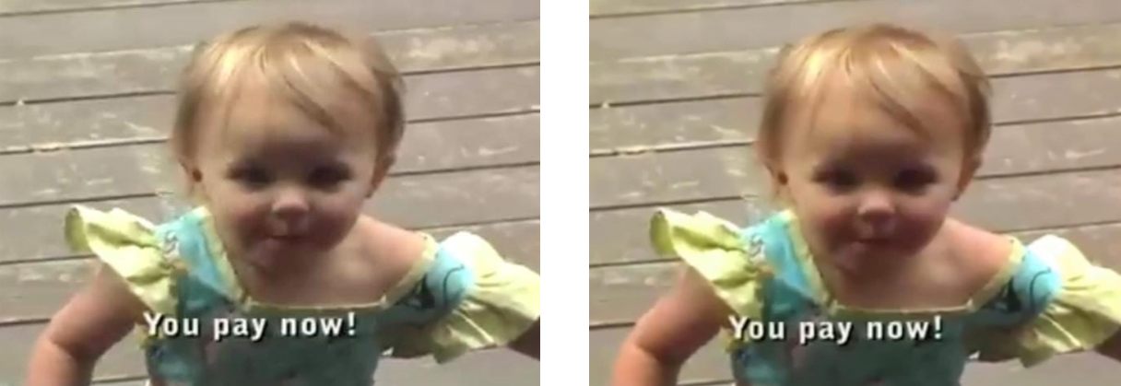
Problem Illustration
With denoising and color enhancements, skin texture, sharpness, and definition remain compromised, compromising visual fidelity and impacting emotional engagement.
Department of Computer Science and Engineering
4

Slide 6
Applications
This lack of focus on facial details limits the potential of video restoration for applications like:
Film and archival preservation: Historical footage loses its expressiveness and emotional impact due to blurry faces.
Forensic analysis: Facial recognition and identification become challenging due to unclear features.
Emotional analysis and sentiment understanding: If faces are blurry, they can miss important emotional cues, making it difficult to understand the sentiment of the video content.
Virtual reality and augmented reality: If the source video has blurry faces, it can be difficult to create convincing avatars or overlay digital elements onto real-world faces.
Biometrics and surveillance: if video footage has blurry faces, it can significantly reduce the accuracy and effectiveness of facial recognition systems
Department of Computer Science and Engineering
4

Slide 7
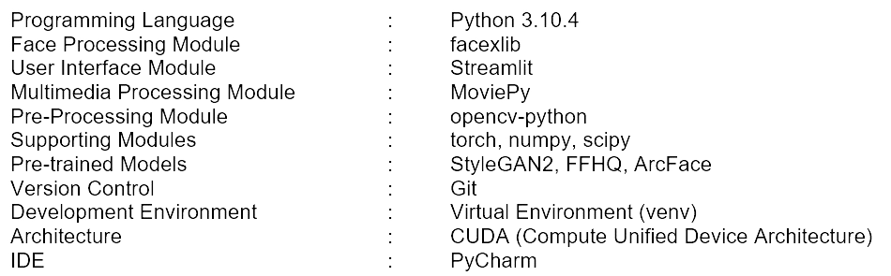
Experiment Environment
Department of Computer Science and Engineering
4

Slide 8
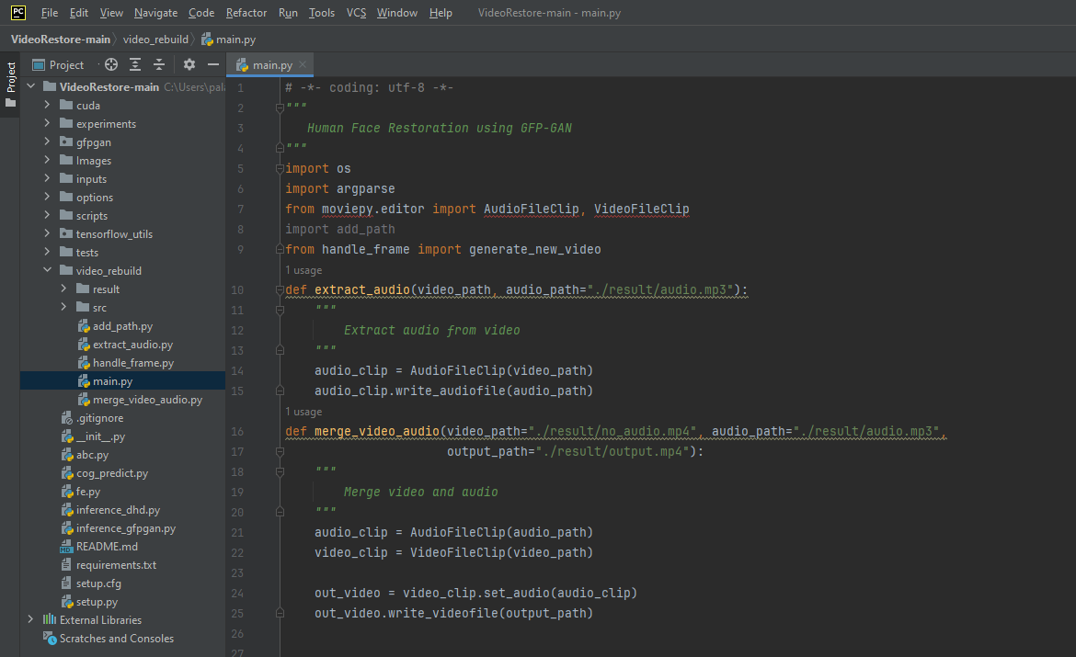
Experiment Environment
(1/4)
Model building Phase
(Audio Module)
IDE: PyCharm
Language: Python programming
Department of Computer Science and Engineering
6

Slide 9
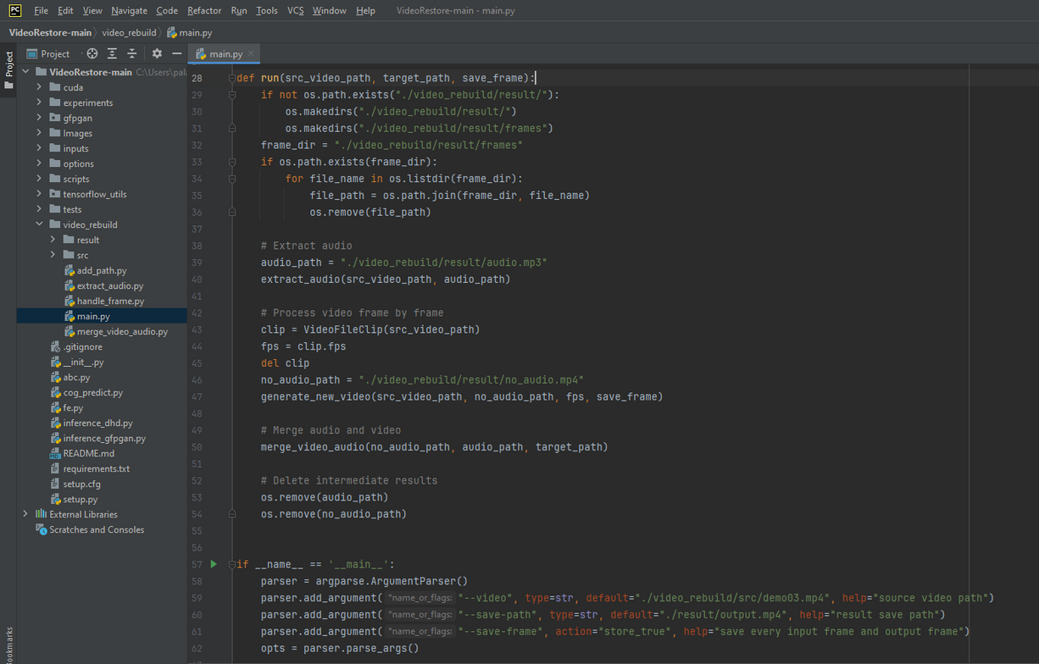
Experiment Environment
(2/4)
Model building Phase
(Audio Module & Command Parser)
IDE: PyCharm
Language: Python programming
Department of Computer Science and Engineering
6

Slide 10
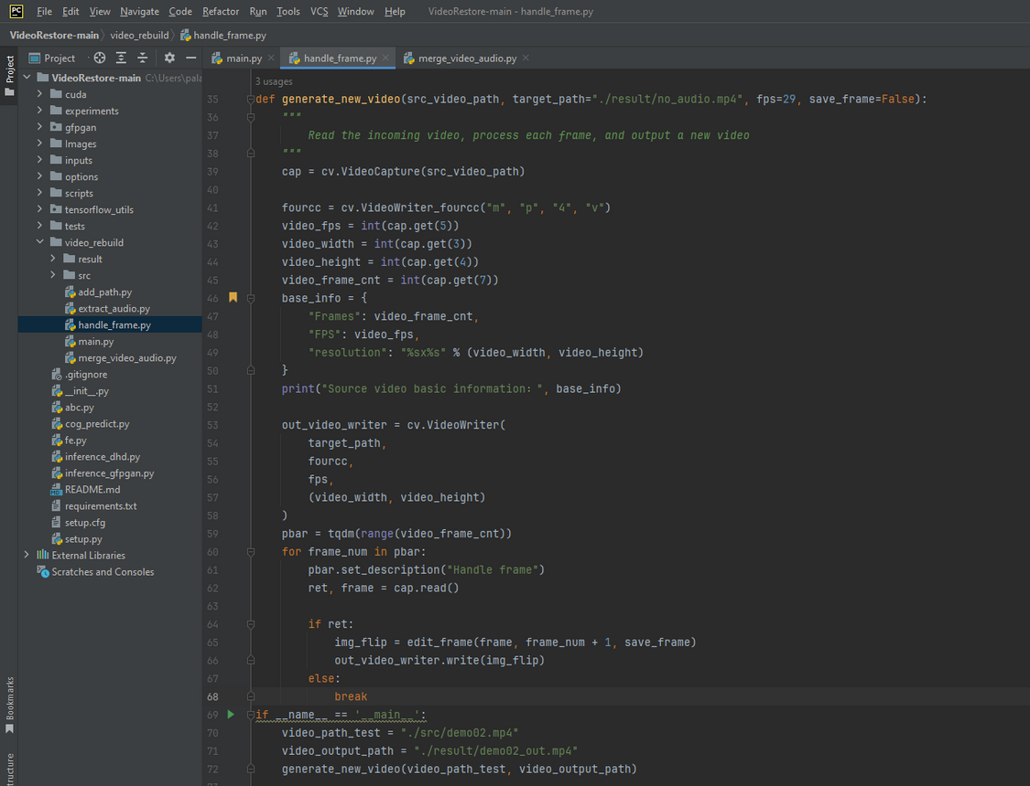
Experiment Environment
(3/4)
Model building Phase
(Video Generation Module)
IDE: PyCharm
Language: Python programming
Department of Computer Science and Engineering
6

Slide 11
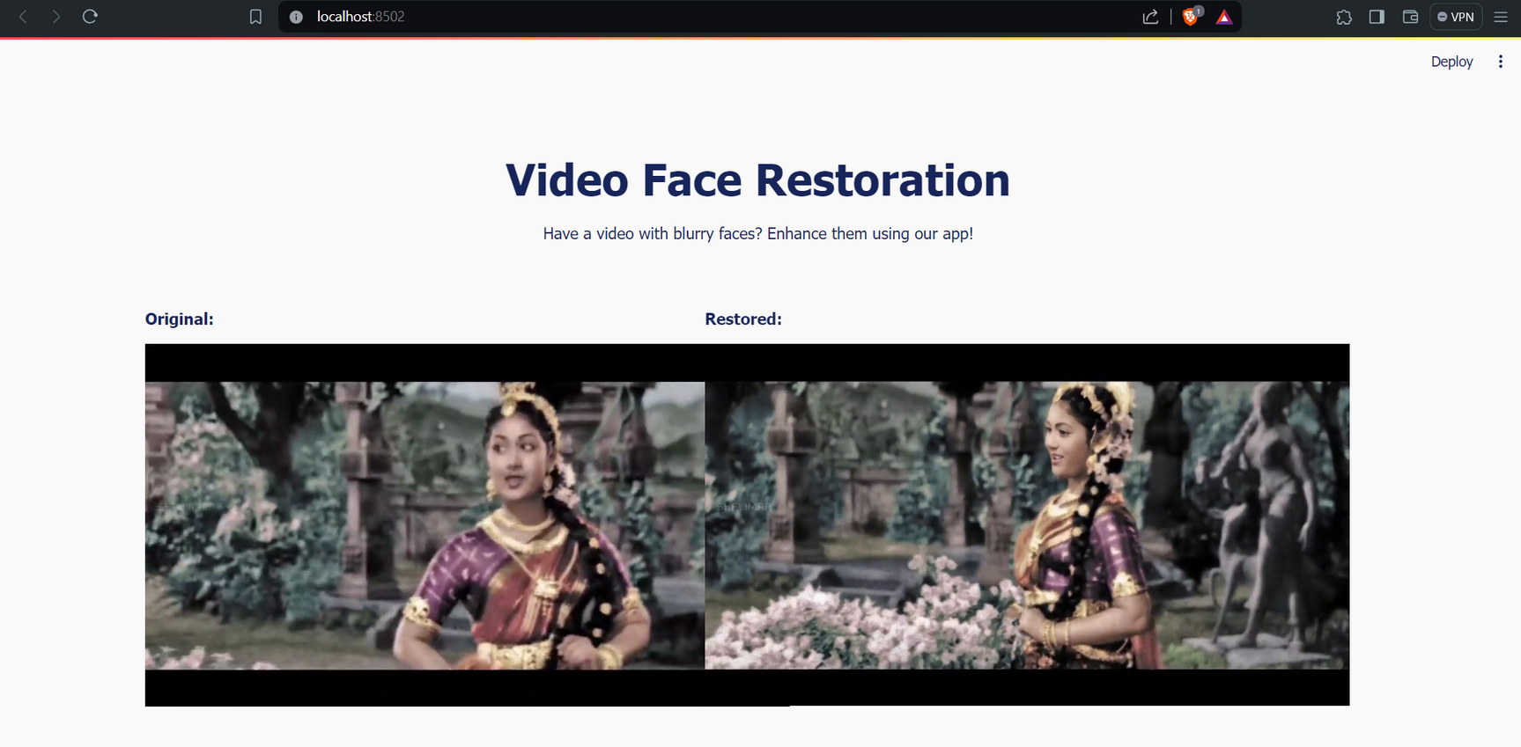
Experiment Screen shot
(1/3)
User interface (UI)
6

Slide 12
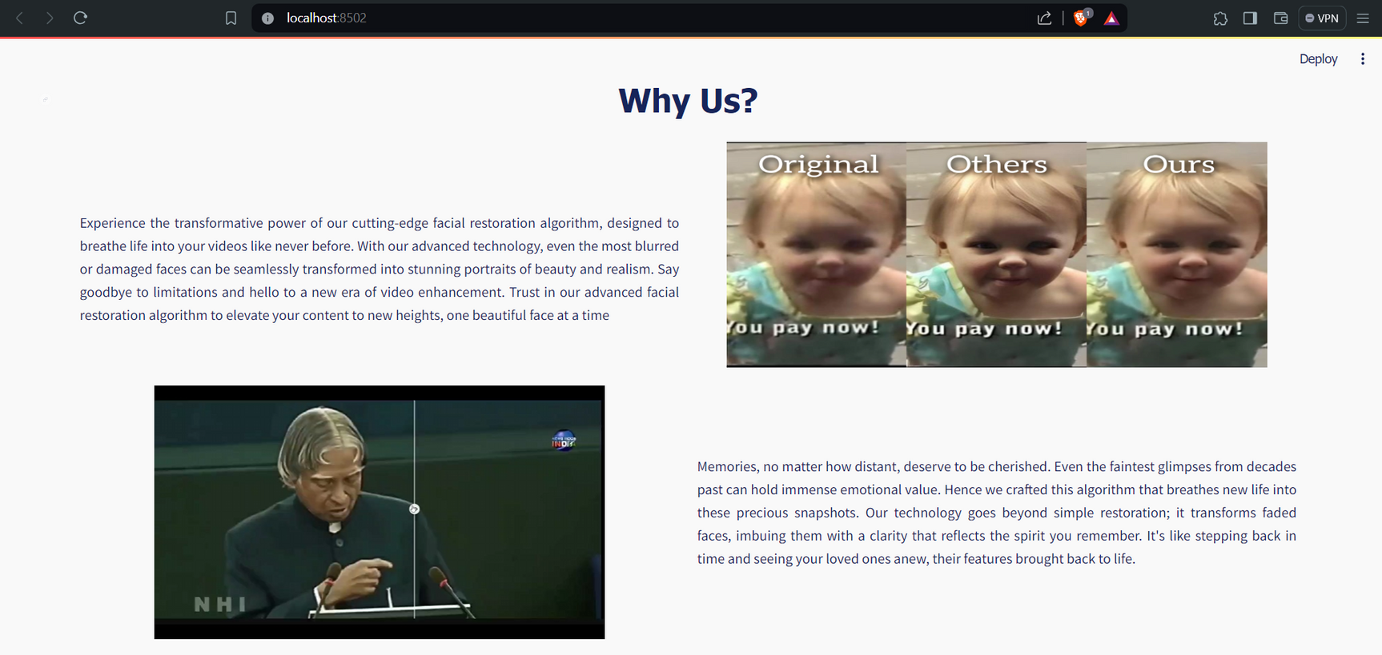
Experiment Screen shot
(2/3)
User interface (UI)
6

Slide 13
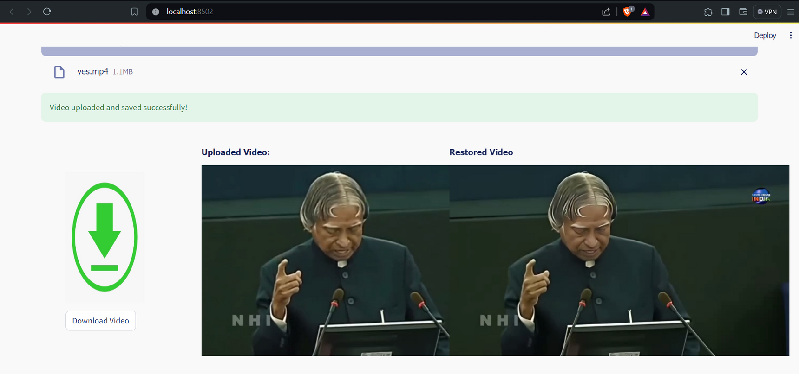
Experiment Screen shot
(3/3)
User interface (UI)
6

Slide 14
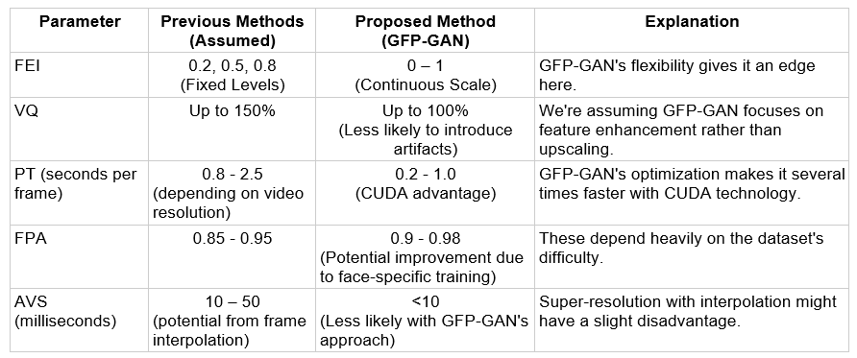
Parameters
5

Slide 15
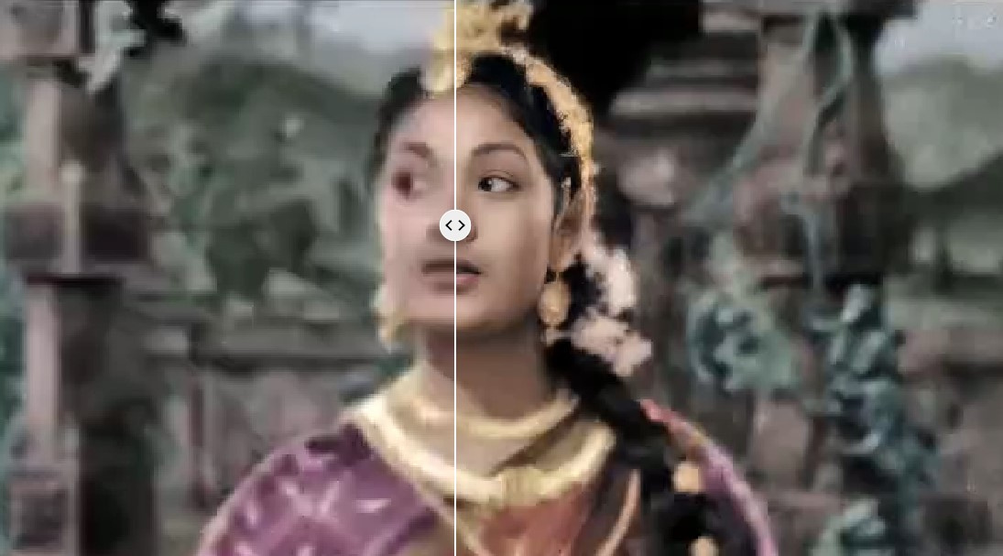
Justification Experiment results
Experiment Finding 1: Significant Enhancement in Visual Quality
Method: Conducted a qualitative comparison between original videos and their GFPGAN-enhanced counterparts.
Findings:
Sharper facial features (eyes, mouth, etc.)
Improved textures and reduction of compression artifacts.
Increased overall visual appeal
5

Slide 16
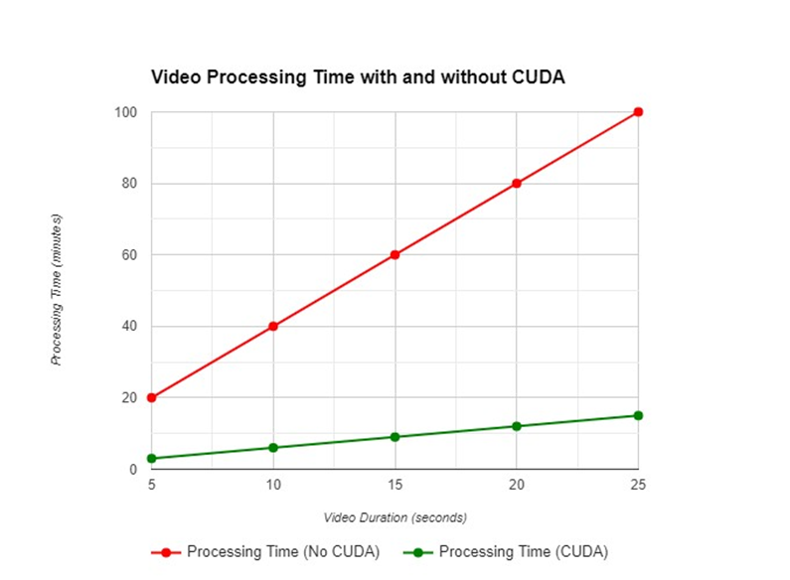
Justification Experiment results
Experiment Finding 2: CUDA-Accelerated Processing Speed
Method: Accurately measured processing time with and without CUDA acceleration for videos of varying length and resolution. Calculated speedup factors.
Findings:
Substantial decreases in processing time when utilizing CUDA compared to CPU-only processing.
The GFP-GAN algorithm performs 666.67% faster with CUDA technology compared to regular CPU dependency
5

Slide 17
References
[1] Wang, X., Yu, L., Zhou, S., & Zhang, D. (2021). GFPGAN: Towards real-world blind face restoration with generative facial prior. In Proceedings of the IEEE/CVF Conference on Computer Vision and Pattern Recognition (pp. 1505-1514).
[2] Yue, W., Liu, Y., Liu, J., Sun, J., & Wang, T. (2022). DifFace: Blind face restoration with diffused error contraction. arXiv preprint arXiv:2206.05477.
[3] Jiang, Y., Zhou, Z., Loy, D., & Tang, X. (2022). GLEAN: Generative latent bank for large-factor image super-resolution. In Proceedings of the IEEE/CVF Conference on Computer Vision and Pattern Recognition (pp. 3149-3158).
[4] McFee, B. (2021). moviepy: Video editing for Python.
5

Slide 18
Thank you
5

